Slide 1
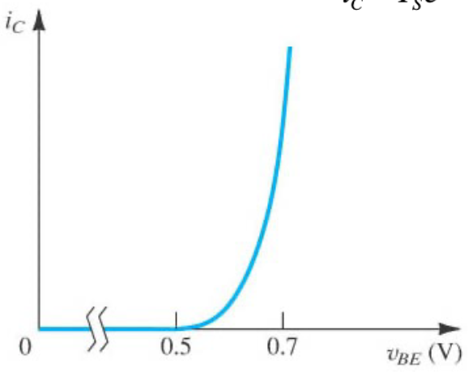
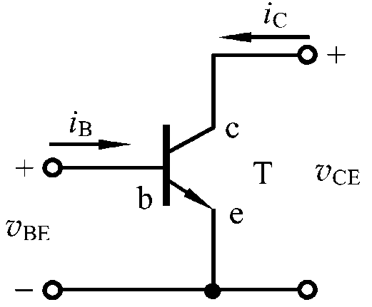
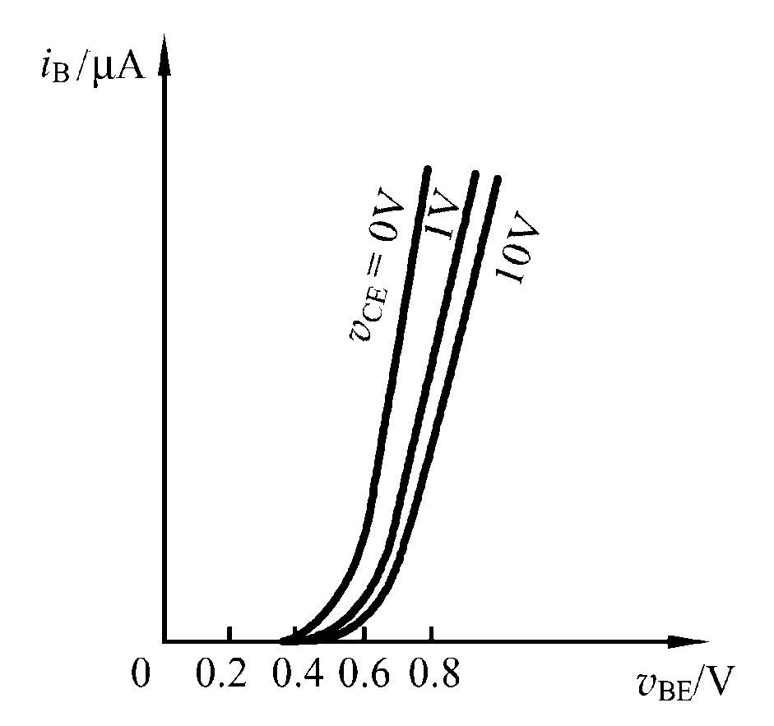
i_{C} ~ υ_{BE} curve:
i_{B} ~ υ_{BE} curve:
Uon
Si: 0.5 – 0.7 V
Ge: 0.1 – 0.3 V
Holes from
B to E
Electrons from
E to B
Notes:
Ic curve should be plot here.
Why ic is controlled by VBE rather tan VCE?

Slide 2
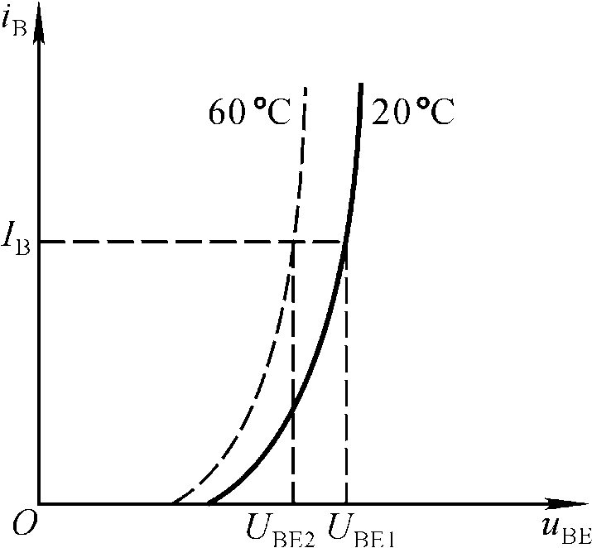
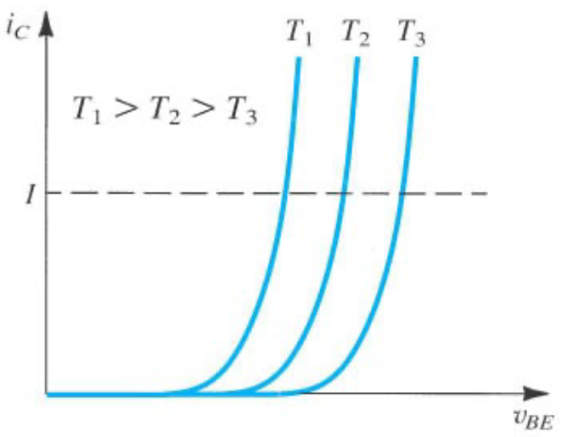
Temperature effects on I-V curves

Slide 3
When v_{ce} changes, how will the curve move?

Slide 4
Bipolar Junction Transistors
Peng Mei
Department of Electronic Systems
Email: mei@es.aau.dk

Slide 5
Learning objectives:
Simple NPN transistor model
Concept of transconductance
Large-signal and small-signal model

Slide 6
Current gain

Slide 7
According to KCL:
or

Slide 8
Can we simplify this circuit model?

Slide 9
Simple bipolar transistor model
Voltage controlled
current source

Slide 10
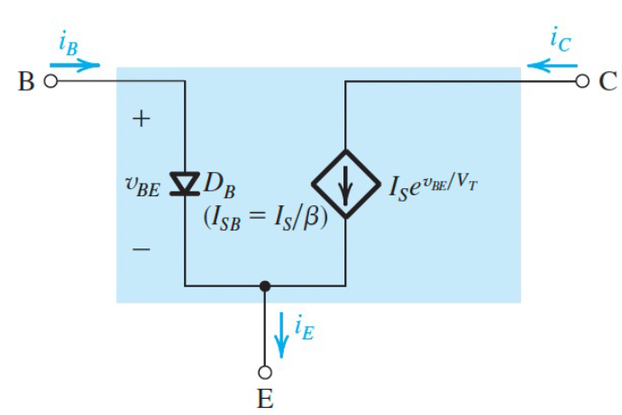
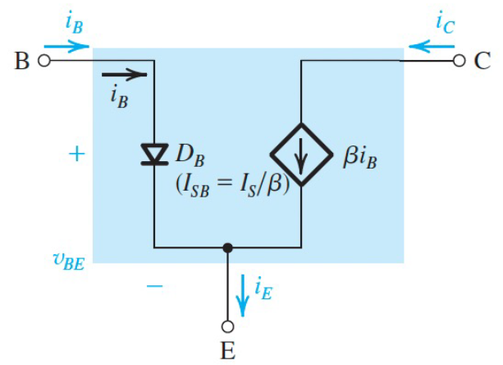
Simple bipolar transistor model
Application of a simple bipolar transistor model

Slide 11
Application of a simple bipolar transistor model
Calculate i_{c} ?
Vo = 5V, V_{CE} = 12V, Ro = 100 Ω

Slide 12
Application of a simple bipolar transistor model
Vo = 5V, V_{CE} = 12V, Ro = 100 Ω

Slide 13
Concept of transconductance:
When v_{BE} has a fluctuation, how will it affect i_{C}?

Slide 14
Concept of transconductance:

Slide 15
Large-signal and small-signal model:
Large-signal: the signal is arbitrarily large
Small-signal: the signal perturbs the bias point by only a small amount
(small compared to V_{T})

Slide 16
i_{C}
i_{B}
V_{in}

Slide 17
i_{C}
i_{B}
V_{in}
V_{in}
In small-signal model:
DC sources are short.

Slide 18
V_{in}
V_{in}
V_{in}

Slide 19
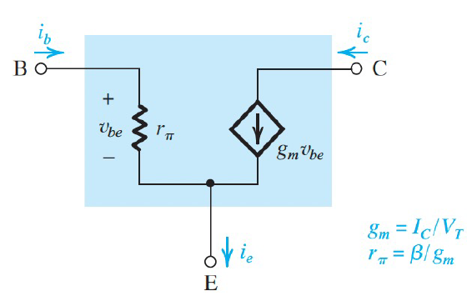

Slide 20
Draw the large-signal and small-signal models?

Slide 21
Thanks

